Slide 1
How Service Providers Can Leverage Lithium-Ion Back up Batteries
5/2022
5G Telecom and EDGE Equipment
Webinar Sponsored By
RCR Wireless

Slide 2
Speakers
JD DiGiacomandrea, P.E.
Product Marketing Engineer
Green Cubes
Jeff VanZwol
Chief Marketing Officer
Green Cubes
RCR Wireless

Slide 3
Agenda
Speakers
Introduction
Applications
Lithium Basics
Market Drivers
Regulatory
Further Reading
Lithium batteries are being deployed in more stationary UPS and backup power applications and displacing lead acid batteries. But why are Lithium batteries growing in 5G telecom and EDGE deployments now?

Slide 4
Our Value Proposition
The Power to Perform
Green Cubes designs and manufactures rechargeable lithium-ion battery solutions that are safe and accessible. Our solutions ease the migration away from Lead Acid, Internal Combustion Engines (ICE), and other older technologies.
Our vision is to design platforms to help accelerate the adoption of clean energy mediums.

Slide 5
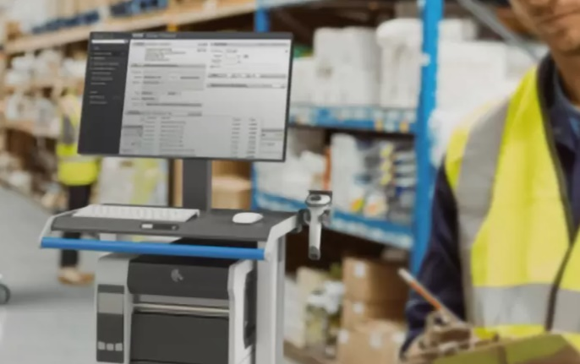
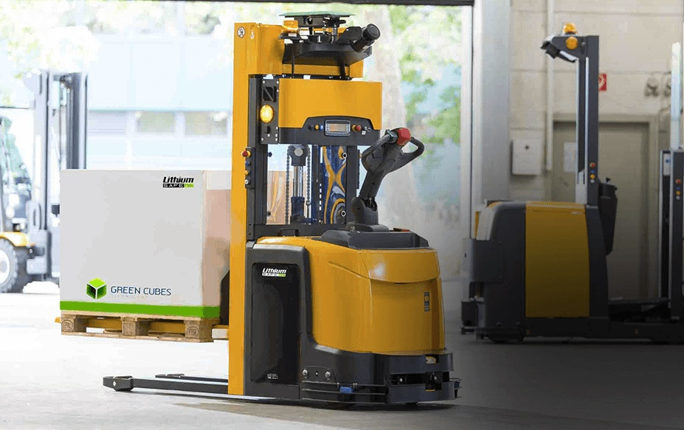
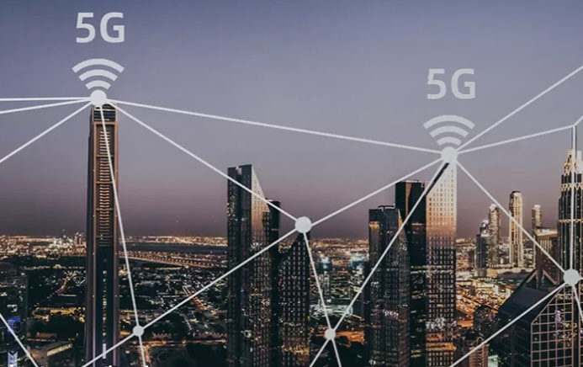
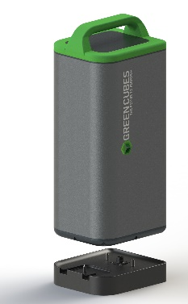
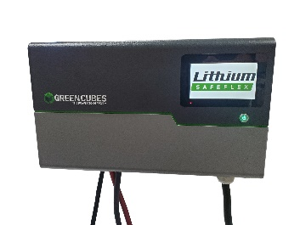
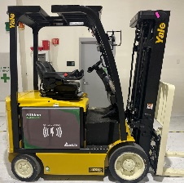
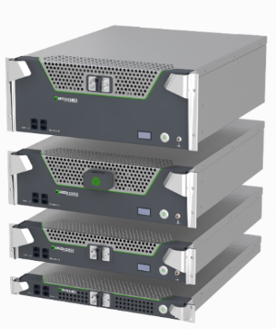
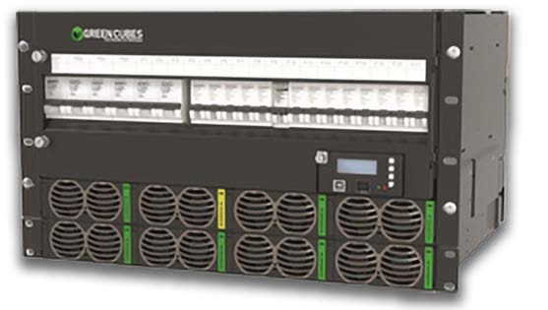
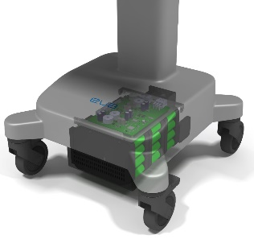
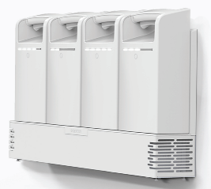
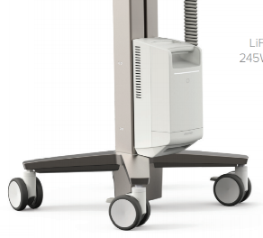
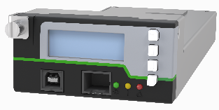
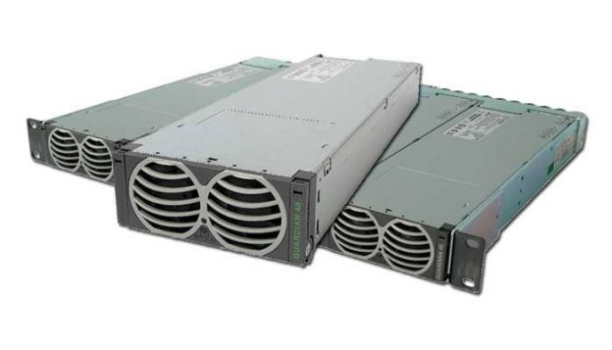
Industrial Electrification Across Three Markets
Segment | Mobile |  | Motive |  | Stationary
Products
Industries | Medical Industrial / warehousing Education |  | Industrial / warehousing Aviation ground support equipment Automated guided vehicles Other large ride-on equipment |  | Telecom Data centers Public and private networks

Slide 6
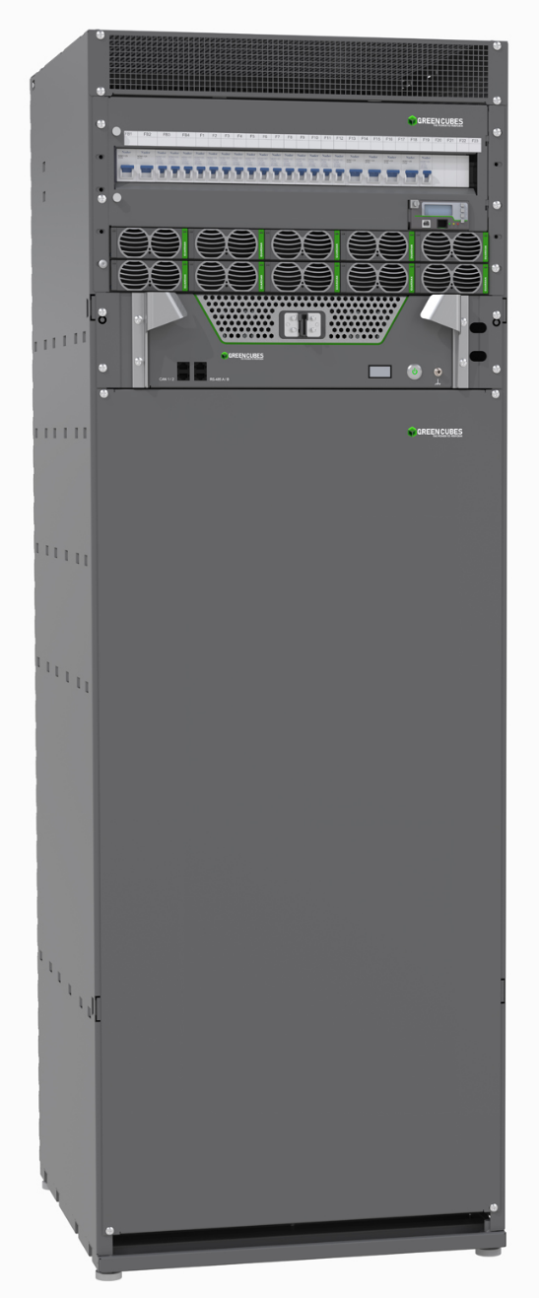
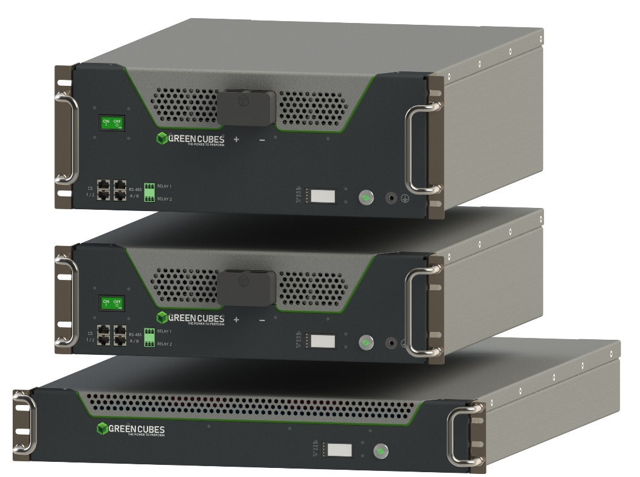
Product Portfolio for Stationary Power
Power Distribution
Complete System Control
AC to DC Conversion
Lithium Batteries

Slide 7
Guardian Battery Units
First telecom battery with Energy Balance Technology (EBT) for easy installation and superior operation:
Current sharing– no issue
Different state of charge – no issue
Different state of health/age – no issue
Basic Specification:
Rack Mount 48V 19” and 23”
Sizes 2U, 3U and 4U
Capacity 105, 160 and 175Ah
Fan cooling
Wide temperature range
Parallel operation >10 battery packs in parallel
Safety/compliance: Global approvals (IEC/CE/UL)

Slide 8
Backup Power Applications
Where do you need backup power?

Slide 9
5G Telecom
Growing coverage areas
Traditional Macro Sites
Exponential Growth in Micro Sites
5G increased power demand
Critical Infrastructure
RCR Wireless

Slide 10
Private Networks
My Network
Privacy
Low Latency
Security
Guaranteed Bandwidth
100% Uptime
Wired and Wireless
Who?
Utilities
Retail
Healthcare
Manufacturing
Transportation
Education
RCR Wireless

Slide 11
EDGE Computing
Data and Processing on premises
Virtualized radio networks & 5G vRAN
Autonomous vehicles
Oil & Gas monitoring
Smart Grid functions
In-Hospital patient monitoring
Traffic management
RCR Wireless
Notes:
2. Remote monitoring of assets in the oil and gas industry
Oil and gas failures can be disastrous. Their assets therefore need to be carefully monitored.
However, oil and gas plants are often in remote locations. Edge computing enables real-time analytics with processing much closer to the asset, meaning there is less reliance on good quality connectivity to a centralized cloud.
3. Smart grid
Edge computing will be a core technology in more widespread adoption of smart grids and can help allow enterprises to better manage their energy consumption.
Sensors and IoT devices connected to an edge platform in factories, plants and offices are being used to monitor energy use and analyse their consumption in real-time. With real-time visibility, enterprises and energy companies can strike new deals, for example where high-powered machinery is run during off-peak times for electricity demand. This can increase the amount of green energy (like wind power) an enterprise consumes.
5. In-hospital patient monitoring
Healthcare contains several edge opportunities. Currently, monitoring devices (e.g. glucose monitors, health tools and other sensors) are either not connected, or where they are, large amounts of unprocessed data from devices would need to be stored on a 3rd party cloud. This presents security concerns for healthcare providers.
An edge on the hospital site could process data locally to maintain data privacy. Edge also enables right-time notifications to practitioners of unusual patient trends or behaviours (through analytics/AI), and creation of 360-degree view patient dashboards for full visibility.
6. Virtualised radio networks and 5G (vRAN)
Operators are increasingly looking to virtualise parts of their mobile networks (vRAN). This has both cost and flexibility benefits. The new virtualised RAN hardware needs to do complex processing with a low latency. Operators will therefore need edge servers to support virtualising their RAN close to the cell tower.
9. Traffic management
Edge computing can enable more effective city traffic management. Examples of this include optimising bus frequency given fluctuations in demand, managing the opening and closing of extra lanes, and, in future, managing autonomous car flows.
With edge computing, there is no need to transport large volumes of traffic data to the centralised cloud, thus reducing the cost of bandwidth and latency.

Slide 12
Backup Power
Regulations Require It
Order 07-177
24 Hours Central Offices
8+ Hours Remote Cell Sites
47 CFR § 9.20
CPUC – 72 Hours!
5G Power Demands increasing
Where does it go?
Edge Applications need it too!
How?
Diesel/Gas Generators
Lead Acid Batteries
Lithium Ion Batteries
RCR Wireless
Notes:
CPUC – California Public Utilities Commission – Feb 2021 Areas with high wildfire risk must have 72 hours backup land line and internet

Slide 13
Li-ion Battery Chemistry
Jeff VanZwol

Slide 14
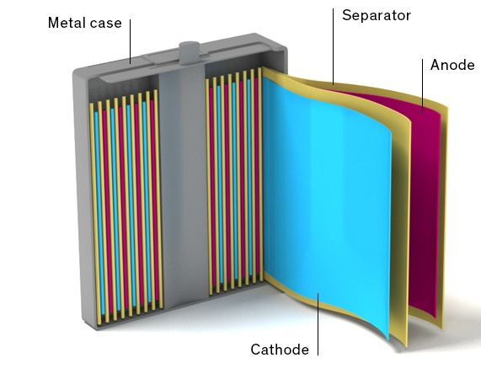
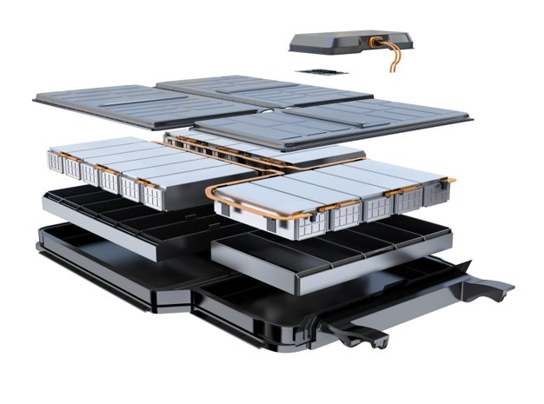
Cell Construction
The Building Blocks of a Battery Pack
Cylindrical, Prismatic, Polymer physical constructions
Anode, Cathode are working parts
Cathode mainly determines performance
Cathode chemistries:
LiCoO2 - Cobalt
Li(NiCoAl)O2 - NCA or Mixed Metal
Li(NiMnCo)O2 - NMC or Mixed Metal
LiFePO4 - LFP or Iron Phosphate

Slide 15
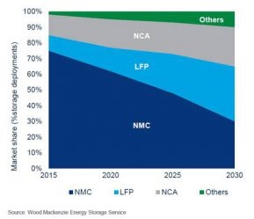
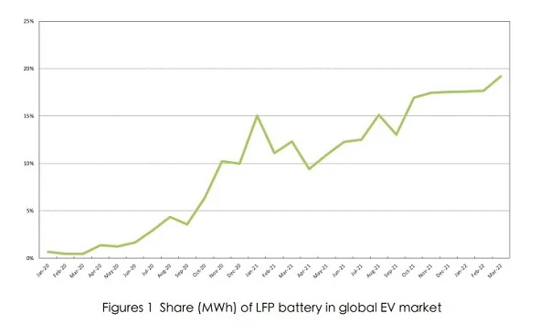
Market Adoption of Li-ion
Application specific formulations
NCA
Highest energy density
Used in EV and consumer electronics
NMC
Balanced performance
Most widely used
Many variations
LFP
Used in industrial motive
Back-up applications
Global market of EVs equipped with LFP batteries*
2020 – 8.9 %
2021 - 14.3%
2022 - 20.6% to 21.5%
* Researcher and Research, 2022

Slide 16
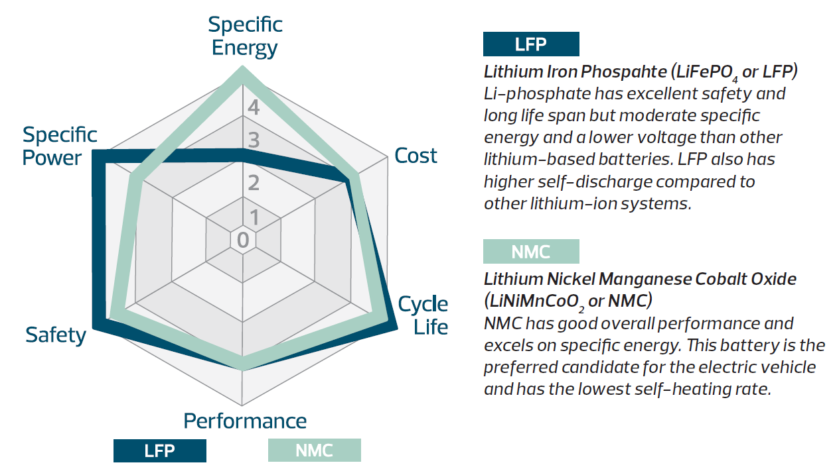
LFP vs NMC
Performance Comparison
SPECIFIC POWER: LFP HAS HIGHER POWER, as LFP can safely provide the high power necessary to efficiently support very fast charges/discharges
SAFETY: LFP HAS HIGHER SAFETY, as LFP has better thermal runaway temperature and overall charge acceptance
SPECIFIC ENERGY: LFP HAS LOWER ENERGY TO WEIGHT AND MASS RATIO, which helps with overall safety.

Slide 17
LFP vs. VRLA
Specifications

Slide 18
Why now?
Advances in Lithium Technologies with JD DiGiacomandrea

Slide 19
Application Demands
EDGE and Telecom needs
Higher power radios demand more storage capacity
Smaller locations require denser chemistry
More locations exponentially increase required infrastructure
Regulations require longer runtimes
Lifetime expectations are increasing 10+ years
Consumer and EV industries scale manufacturing base

Slide 20
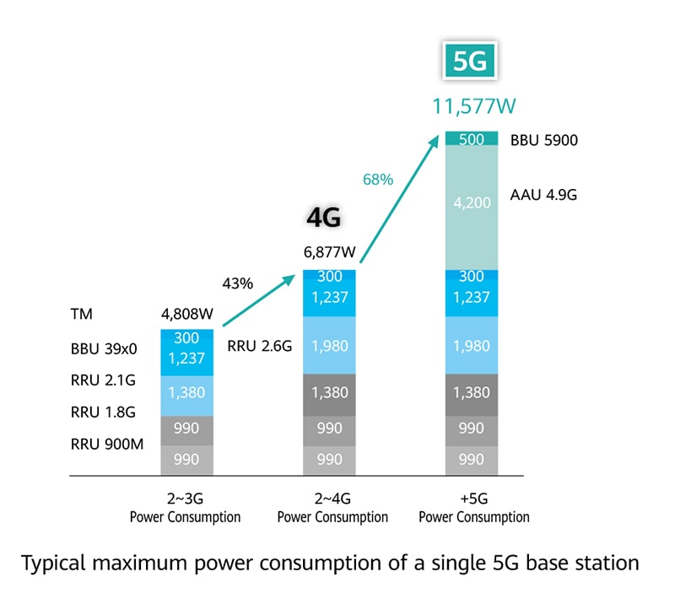
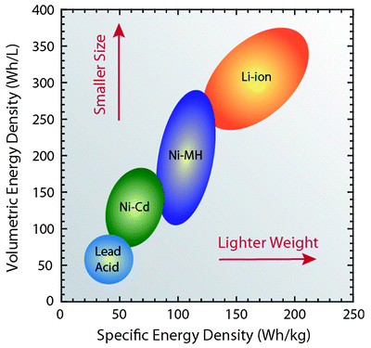
Application Demands
EDGE and Telecom needs
Higher power radios demand more storage capacity
Li-Ion weighs less than Lead Acid
Li-Ion takes up less space than Lead Acid
Images courtesy:
Huawei, RIT
Smaller locations require denser chemistry
More locations exponentially increase required infrastructure
Regulations require longer runtimes
Lifetime expectations are increasing 10+ years
Consumer and EV industries scale manufacturing base

Slide 21
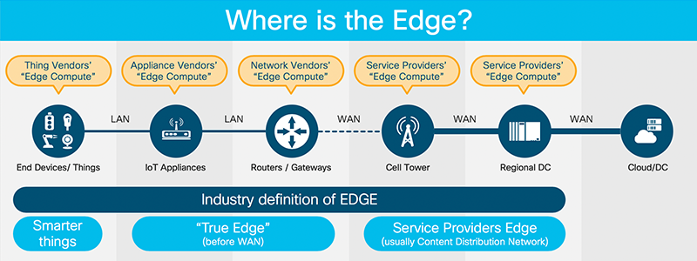
Application Demands
EDGE and Telecom needs
Higher power radios demand more storage capacity
Smaller locations require denser chemistry
Li-Ion fits in smaller locations better
No ventilation required
Can be mounted in any orientation
Images courtesy: Ciso,
(Roberta A. DiLeo, Rochester Institute of Technology)
More locations exponentially increase required infrastructure
Regulations require longer runtimes
Lifetime expectations are increasing 10+ years
Consumer and EV industries scale manufacturing base

Slide 22
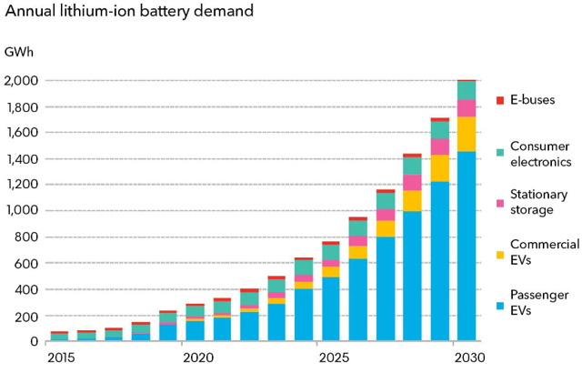
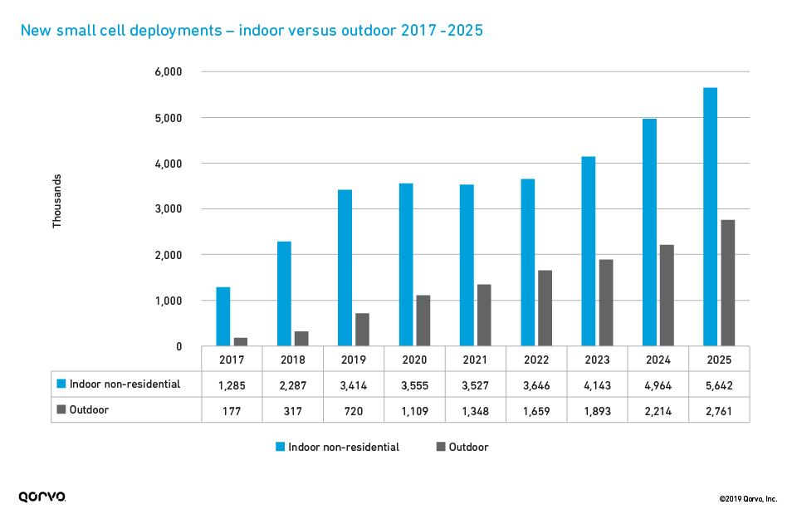
Application Demands
Higher power radios demand more storage capacity
Smaller locations require denser chemistry
EDGE and Telecom needs
More locations exponentially increase required infrastructure
Li-Ion is “Maintenance Free”
No watering, torque checks or visual inspections for leaks required
Remote Battery Management System integrated into all Li-Ion packs
Images courtesy: Bloomberg
Regulations require longer runtimes
Lifetime expectations are increasing 10+ years
Consumer and EV industries scale manufacturing base

Slide 23
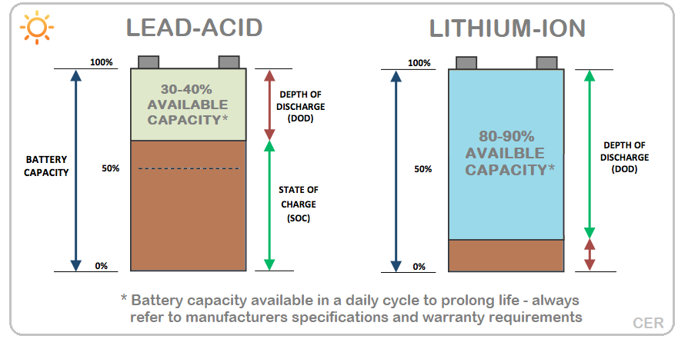
Application Demands
Higher power radios demand more storage capacity
Smaller locations require denser chemistry
EDGE and Telecom needs
More locations exponentially increase required infrastructure
Regulations require longer runtimes
Order 07-177
24 Hours Central Offices
8+ Hours Remote Cell Sites
47 CFR § 9.20
CPUC – 72 Hours!
Li-Ion are 3-4x more energy dense
Li-Ion are capable of 100% DoD w/o damage
Images courtesy: Clean Energy Reviews
Lifetime expectations are increasing 10+ years
Consumer and EV industries scale manufacturing base

Slide 24
Application Demands
Higher power radios demand more storage capacity
Smaller locations require denser chemistry
EDGE and Telecom needs
More locations exponentially increase required infrastructure
Regulations require longer runtimes
Lifetime expectations are increasing 10+ years
Cycle Life
VRLA cycles 250-500
NMC cycles 500-1000
LFP cycles 3000-5000+
Affected by DoD, temperature
Calendar Life
VRLA – 2-5 years
LFP and NMC – 10-15 years
Affected by temperature
Images courtesy: Final Report EP-C-12-014 WA 3-01, 2015, EPA
Consumer and EV industries scale manufacturing base

Slide 25
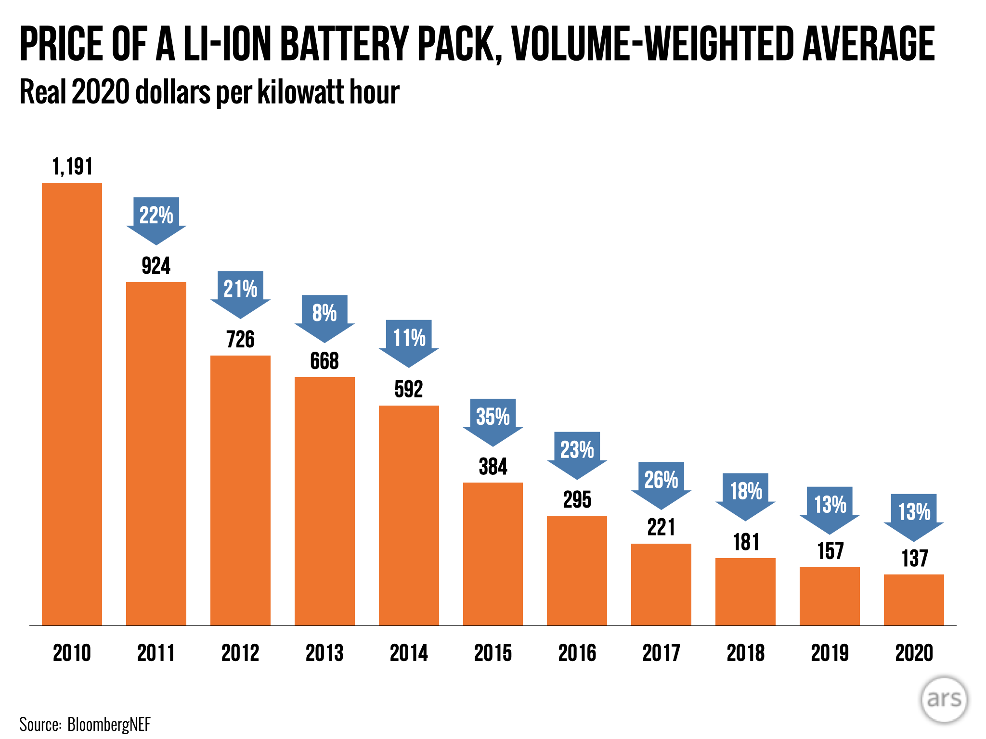
Application Demands
Higher power radios demand more storage capacity
Smaller locations require denser chemistry
EDGE and Telecom needs
More locations exponentially increase required infrastructure
Regulations require longer runtimes
Consumer and EV industries scale manufacturing base
Consumer -> EV Demand
Cell Cost falling, close to Lead Acid
Lifetime expectations are increasing 10+ years
Images courtesy: Seeking Alpha, Bloomberg

Slide 26
Cost or Benefit?
Quantitative analysis – Total Cost of Ownership

Slide 27
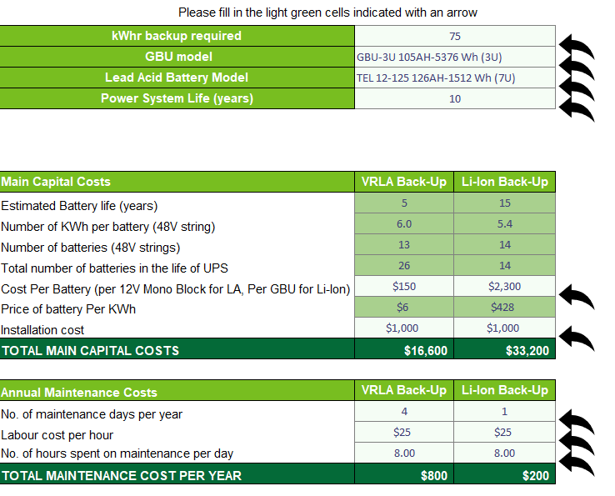
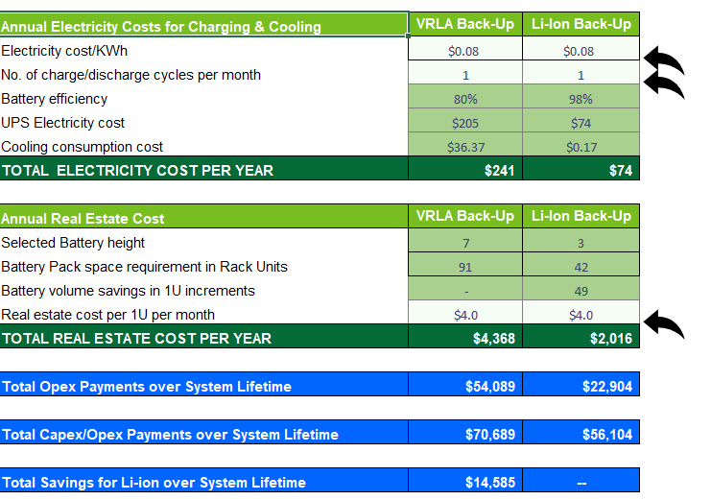
TCO for Li-ion and VLRA Batteries

Slide 28
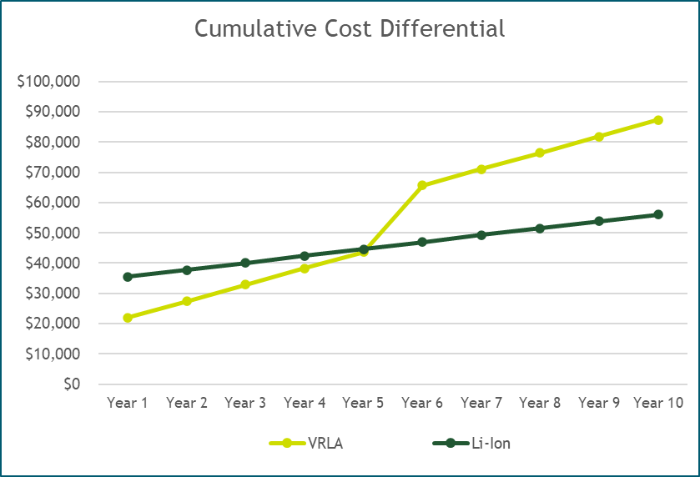
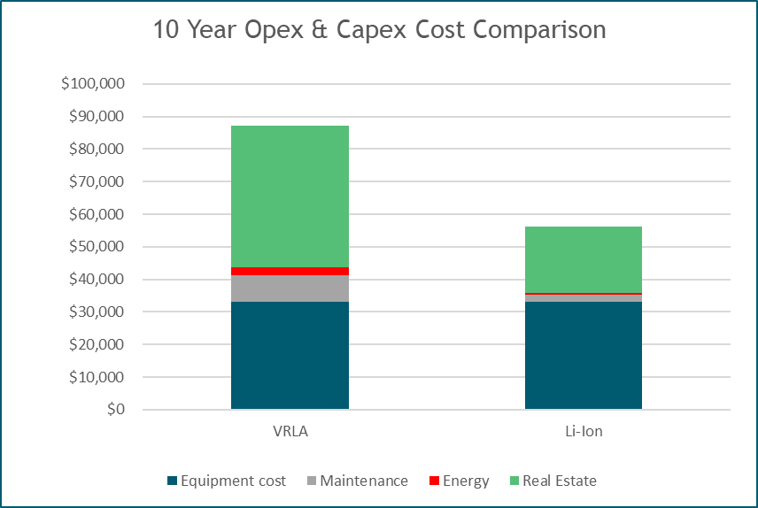
ROI for Li-ion and VLRA Batteries
Initial Capex investment was only slightly higher for Li-ion
Combined Capex/Opex cost for VRLA nearly twice Li-ion over ten year period
Breakeven for Li-ion occurs 5 years from deployment IN THIS CASE
Calculator Available on Green Cubes Website

Slide 29
Regulatory Requirements
A Young Industry

Slide 30
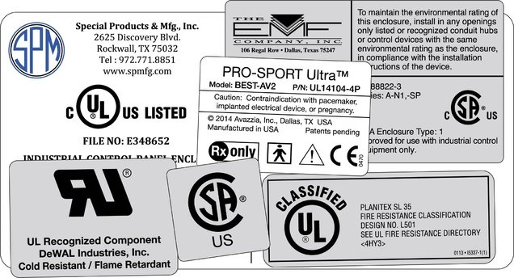
Lithium Ion Regulations
Transportation, Installation, Safety
Transportation
UNDOT 38.3
Installations
UL9540, UL9540A
NFPA 855
UL1973
Safety
IEC62619
UL1642

Slide 31
How can Li-Ion help you?
EDGE or Telecom, Lithium-Ion backup power can enable smaller, lighter, less expensive, and higher performing assets for service providers around the world.

Slide 32
Questions?

Slide 33
THANK YOU

